Slide 1

Nursery 2020 season - Dates
Fri 17th July -Skills
Fri 24th July – Skills
Fri 31st July – No training
Fri 7th Aug - Games
Fri 14th Aug - Skills
Fri 21st Aug - Skills
Fri 28th Aug - Skills
Fri 4th Sep - Games
Fri 11th Sep - Skills
Fri 18th Sep – Skills
Fri 25th Sep - Skills
Fri 2nd Oct - Games
Fri 9th Oct - Games
Fri 16th Oct – Games
Each week when coaching, think about this!!
Stages of a 5 year old
Five-year-olds are cheerful, energetic, and enthusiastic.
They enjoy planning, and spend a great deal of time discussing who will do what .
They especially enjoy dramatic play, usually with other children.
Five-year-olds are more sensitive to the needs and feelings of others around them.
It is less difficult for them to wait for a turn or to share toys and material.
"Best friends" become very important.

Slide 2
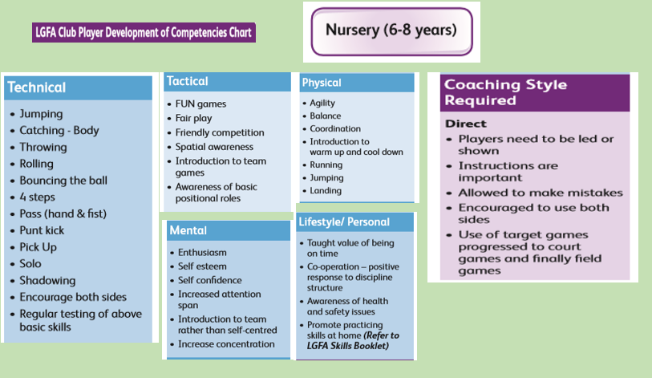

Slide 3
Skills for Nursery Football
Ball familiarisation Practices:
Passing ball around waist
Rolling ball
c) Picking up stationary ball
d) Picking up moving ball
2. Kicking:
Kicking a ball from the hands (punt kick)
Hook Kick
Shooting
3. Passing the ball:
Fist Pass
Hand Pass
4. Catching a ball:
Catching while stationary (low, waist, chest, high)
Catching ball while moving
5. Solo Run
Bouncing a ball
Solo stationary
Solo run on the move
6. Block Down
Stationary block
Blocking on the move
7. Evasion
Side Step
Roll off

Slide 4
Naomh Mhuire U6 Gaelic Training - Plan for Session- Week 1 – Fri 17th July 2020
Station 3 – Fun Games
(relay races – pick up ball and run and place it down, next one goes)
Station 4 - Kicking
(bounce ball and kick, aim for wall, aim for cones and knock them)
OUTLINE OF THE SESSION
Coaches arrive by 4.45pm to set up on area.
Each coach takes 1 station to run (see plan)
Set up your station – Equipment will be available. Covid Sup will let girls in as they arrive with screenshot of health questionnaire.
5pm Girls start to arrive, give them a bib and name tag. Aim for no more than 6 girls per group.
5.05pm - Warm up as big group – can play tag, stuck in mud, Simon says
5.10pm – Move girls to station and explain – groups are in bibs at this stage.
5 mins at each station – on whistle all groups move at the same time in a clockwise direction to the next station.
5.40pm – Cool down game– 1 coach lead - Fun game with the group. Rest coaches - Gather up all equipment and sanitise.
5.55pm – Get girls ready to be collected - bring all belongings and water bottles. Parents collect at gate, walk girls over and ensure they are all collected.
Station 2 - Circuit
Ladders, hurdles – practice footwork
Station 5 – Catching Games
(girls in pairs rolling and catching, throwing to chest, overhead catch)
Station 1 - Bouncing Ball
Stationer, then moving. Ball each.
Station 6 - Games
3 v 3 passing game

Slide 5
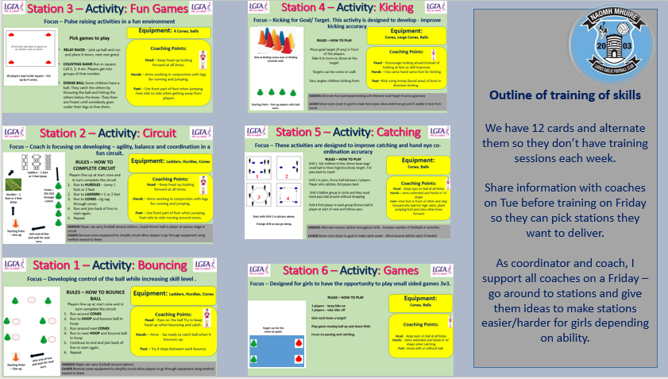

Slide 6
Naomh Mhuire U6 Gaelic Training - Plan for Session- Week 2 – Fri 24th July 2020
Station 3 – Fun Games
(relay races – pick up ball and run and place it down, next one goes)
Station 4 - Kicking
(bounce ball and kick, aim for wall, aim for cones and knock them)
OUTLINE OF THE SESSION
Coaches arrive by 4.45pm to set up on area.
Each coach takes 1 station to run (see plan)
Set up your station – Equipment will be available. Covid Sup will let girls in as they arrive with screenshot of health questionnaire.
5pm Girls start to arrive, give them a bib and name tag. Aim for no more than 6 girls per group.
5.05pm - Warm up as big group – can play tag, stuck in mud
5.10pm – Move girls to station and explain – groups are in bibs at this stage.
5 mins at each station – on whistle all groups move at the same time in a clockwise direction.
5.40pm – Cool down game– 1 coach lead - Fun game with the group. Rest coaches - Gather up all equipment and sanitise.
5.55pm – Get girls ready to be collected - bring all belongings and water bottles. Parents collect at gate, walk girls over and ensure they are all collected.
Station 2 - Circuit
Ladders, hurdles – practice footwork
Station 5 – Passing & Catching Games
(girls in pairs rolling and catching, throwing to chest, overhead catch)
Station 1 - Bouncing Ball
Stationer, then moving. Ball each.
Station 6 - Games
3 v 3 passing game

Slide 8
Naomh Mhuire U6 Gaelic Training - Plan for Session- Week 3 – Fri 7th Aug 2020
Station 3 – Fun Games
(relay races – pick up ball and run and place it down, next one goes)
Station 4 - Kicking
(bounce ball and kick, aim for wall, aim for cones and knock them)
OUTLINE OF THE SESSION
Coaches arrive by 4.45pm to set up on area.
Each coach takes 1 station to run (see plan)
Set up your station – Equipment will be available. Covid Sup will let girls in as they arrive with screenshot of health questionnaire.
5pm Girls start to arrive, give them a bib and name tag. Aim for no more than 6 girls per group.
5.05pm - Warm up as big group – can play tag, stuck in mud
5.10pm – Move girls to station and explain – groups are in bibs at this stage.
5 mins at each station – on whistle all groups move at the same time in a clockwise direction.
5.40pm – Cool down game– 1 coach lead - Fun game with the group. Rest coaches - Gather up all equipment and sanitise.
5.55pm – Get girls ready to be collected - bring all belongings and water bottles. Parents collect at gate, walk girls over and ensure they are all collected.
Station 2 - Circuit
Ladders, hurdles – practice footwork
Station 5 – Passing & Catching Games
(girls in pairs rolling and catching, throwing to chest, overhead catch)
Station 1 - Bouncing Ball
Stationer, then moving. Ball each.
Station 6 - Games
3 v 3 passing game

